Slide 1
Successful Dental Practices: Barriers, Challenges and Success Stories
Strengthening the Oral Health Safety Net Initiative
Caroline Darcy, Project Manager
October 13, 2016

Slide 2
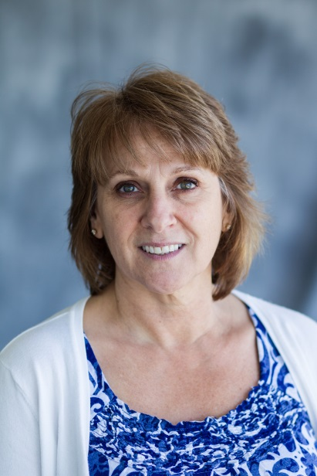
Speaker Bio: Caroline Darcy
Project Manager with Safety Net Solutions for over four years
Works directly with safety net dental programs to provide technical assistance, coaching & motivation
Presents at national conferences on various practice management subjects
Bachelor of Arts degree from Emmanuel College in Boston, MA

Slide 3
Today We Will Talk About
The Strengthening the Oral Health Safety Net (SOSHN) Initiative
Common Challenges Participants Faced
4 Participant Success Stories in the areas of Finance, Access and Quality
2 Successful Participants who will tell their stories
Dr. Maryna Petrasheuskaya DDS
Associate Dental Director
Community Health Net
Bev Myers Director of Dental Care Services
Keystone Dental Care

Slide 4
Results
Many of the programs in this initiative have not only strengthened their financial situations, but have also increased access, all while maintaining quality excellence in dentistry

Slide 5
Who We Are
Safety Net Solutions (SNS) is a program of the DentaQuest Institute (DQI)
DQI is part of the DentaQuest Enterprise whose mission is to improve the oral health of all
DQI is an improvement organization focused on creating an effective and efficient oral health care delivery system
SNS provides practice management technical assistance consulting to safety net dental programs helping them achieve their goals in areas such as increased access, strengthened financial viability, and improved quality outcomes
Notes:
SNS has been in existence for over 10 years under the direction of our Executive Director, Dr Mark Doherty and our Program Manager, Dori Bingham

Slide 6
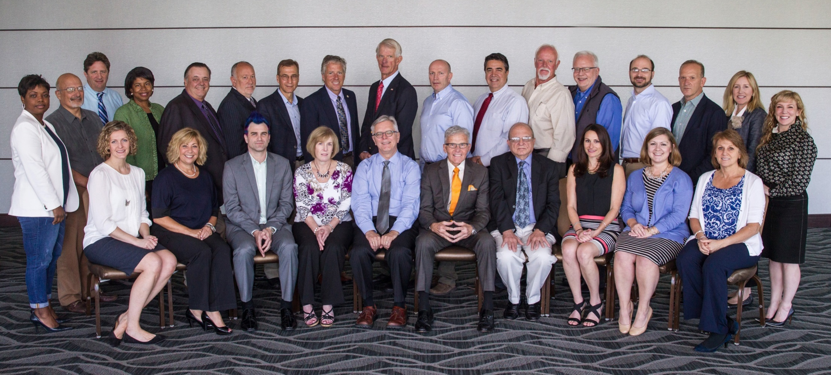
The Safety Net Solutions Team and Expert Advisors
SNS is: (L) Danielle, Laura, Dori, Mark, Da-Nell and Caroline
Notes:
We work with a roster of Expert Advisors across the country who have served as dental directors and manged Safety Net Dental Programs for a number of years.

Slide 7
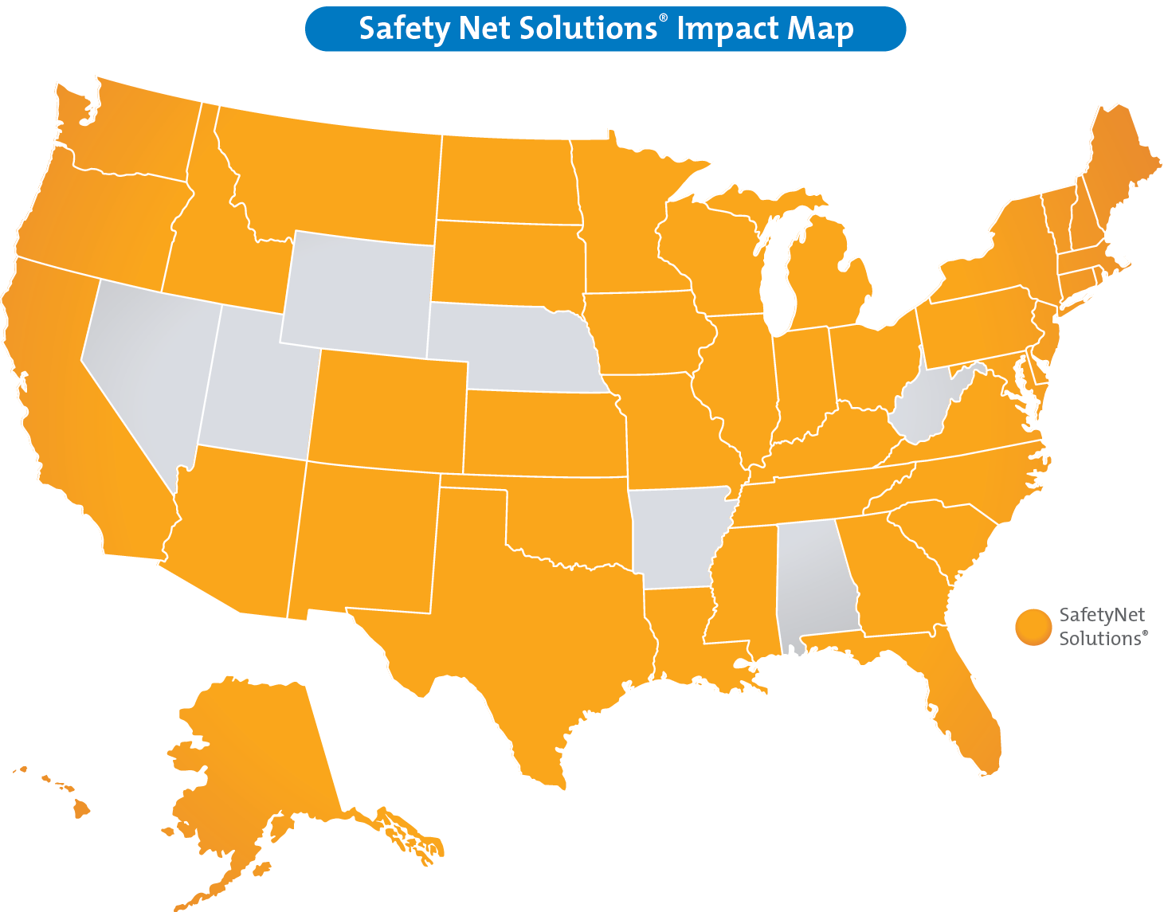
43 states
+ the District
of Columbia
Over 450 programs
Notes:
Over the past 10 years we have worked with over 450 safety net programs in 43 states & the District of Columbia.

Slide 8
SNS’ Involvement in SOHSN
Provided one-on-one technical assistance to 15 safety net dental programs in Pennsylvania over three years
TA involved an in-depth data analysis, site visit, practice improvement plan, implementation call, and ongoing remote TA and evaluation for 24-months
Conducted webinars on topics such as scheduling, no-shows, and sliding fee discount schedules
Presented at PCA annual conferences and dental director meetings, and at regional oral health convenings
Notes:
practice management consulting - Upon completion of a comprehensive analysis of the practices’ financial, operational, and clinical data, Safety Net Solutions performed site visits to each program to meet with key staff and leadership and discuss improvement recommendations.

Slide 9
The Initiative was Launched in 2011 Primary Care Associations
Arizona
Georgia
Illinois
Kansas
Pennsylvania
Alaska
Bi-State
California
Iowa
Mississippi
Michigan
Oregon
Ohio
Tennessee

Slide 10
The PCA plays an important role
Building relationships with other community-based organizations on the state, county and local levels
Advocating for oral health policy change
Training medical staff and health center administration on the importance of oral health
Training dental staff on topics such as billing and coding, medical-dental integration, and meaningful use
Facilitating peer-to-peer learning for dental directors, dental clinic managers and other dental staff
Providing a platform for interprofessional learning for medical, dental and administrative staff

Slide 11
Year One - 2012 - 2014
Esperanza Health
Family First Health
Keystone Dental Care
Sadler Health
Scranton Primary Health
Year Two - 2013 - 2015
Cornerstone Care
Covenant House
Delaware Valley
Keystone Rural Health Consortia
Welsh Mountain
Year Three - 2014 – 2016
Rural Health of Northeastern Pennsylvania
Susquehanna Community Health and Dental Clinic
City of Philadelphia Department of Public Health Dental Clinic
East Liberty
Community Health Net

Slide 12
Common Challenges
Provider productivity below national benchmarks
Lack of knowledge related to benchmarks
Operational issues that negatively impacted productivity
Lack of clearly defined & communicated productivity goals
Hygiene program not being fully utilized

Slide 13
Common Challenges
Scheduling Issues
Staff that are scheduling appointments are not trained as to how to schedule dental appointments
Appointment lengths
Too long or too short
Bringing in more patients than the practice can accommodate
Leads to long waits for follow up care
Not using designated access to protect priority slots

Slide 14
Common Challenges
Staffing issues
Insufficient number of reception/registration staff
Insufficient number of dental assistants for dentists
Lack of hygienists
Lack of a fully dedicated dental manager

Slide 15
Common Challenges
High broken appointment rates
Weak (or non-existent) policies
Lack of consistently following policies
Not making confirmation calls early enough to respond to last-minute cancelations
Not enough time to fill those slots

Slide 16
Common Challenges
Billing and Collections Issues
Inconsistency of collecting patient’s share at the time of the visit
Inconsistency in determining patients’ eligibility
Difficulty in collecting from 3rd party payers
Commercial insurance
Lower than expected revenue per visit due to billing and collections issues

Slide 17
Common Challenges
Technology issues
Inability to maximize functionality of EDR
Lack of training
Poor system set-up
Lack of integration with EMR
Technological limitations
Limited licenses
Software glitches

Slide 18
Common Challenges
Lack of policies & procedures specific to dental
Outdated or missing
Not a separate P & P for dental
Missing critical policies
Scheduling
Emergencies
Broken Appointments
Quality Management

Slide 19
Common Challenges
Program Evaluation
Lack of practice goals
Lack of key data to evaluate practice performance
Lack of accurate & timely data
Program performance not being monitored on a regular basis

Slide 20
Common Challenges
Quality Management
Lack of QA policy
Lack of QA being done regularly
Chart Reviews
Getting staff on board with implementing QI measures

Slide 21
Common Challenges
Dental Leadership
Dental leadership not involved in overall health center planning & operations
Dental leadership not involved in creating budget or goals
No clearly defined roles, responsibilities or reporting structure
Need for better communication and teamwork between administrative and dental leadership
Work more closely with Senior Management
Notes:
Buy-in from administration (CEO, CFO, COO, etc.) is crucial to the success of a dental program
In order to achieve this, dental leadership must be part of the health center leadership team and the dental program must be integrated in overall health center operations

Slide 22
What Does Success Look Like?
Financial sustainability
Increased Access
Quality dentistry
Notes:
What do we measure to evaluate these 3?

Slide 23
20 Metrics to Measure:
Gross Charges
Net Revenue
Expenses
Number of visits
Revenue per visit
Cost per visit
# of Unduplicated Patients
# of New Patients
# of Transactions
Broken Appointment Rate
Emergency Rate
Payer Mix Percentages
Scope of Service
# FTE Providers
# FTE Billing Staff
A/R past 90 days
Treatment Completion Rate
# of children receiving sealants (under 21)
# of sealants applied
% Children seen receiving a preventive service

Slide 24
 | Baseline | 6 months | 12 months | 18 months | 24 months
Gross Charges | $1,393,972 | $477,257 | $571,678 | $0 | $0
Net Revenue | $0 | $64,204 | $52,059 | $0 | $0
Expenses | $0 | $0 | $0 | $0 | $0
Number of Visits | 10,937 | 9,676 | 8,604 | 7,502 | 8,439
Visits per Patient | 0 | 1.6 | 1.5 | 1.3 | 1.4
Unduplicated Patients | 0 | 6,126 | 5,772 | 5,844 | 5,868
New Patients | 2,568 | 1,790 | 1,588 | 1,338 | 2,269
Number of Procedures | 17,056 | 0 | 16,738 | 10,296 | 19,033
Procedures per Visit | 1.6 | 0 | 1.9 | 1.4 | 2.3
Broken Appointment Rate | 52% | 64% | 66% | 42% | 42%
Emergency Rate | 17% | 17% | 15% | 16% | 12%
FTE Dentists | 6.95 | 5.12 | 7.2 | 7 | 5.95
FTE Hygienists | 0 | 0 | 0 | 0 | 1
Number of Sealants | 96 | 66 | 0 | 68 | 137
Patients Receiving Sealants | 0 | 61 | 112 | 0 | 0
Client A
Notes:
Adm won’t release expenses – fights for revenue – can’t establish whether they are losing or gaining? What are their cost per visit or revenue per visit? Who knows?
More new patients – added a hygienist? More procedures per visit – more getting done per visit
Initially they fought broken apt ideas until they saw their numbers going up 6 out of 10 patients not showing up–but eventually they started to enforce – down 10% from base – this by correlation decrease their emergency rate (where their emergencies true emergencies) – added a hygienist started to see more children – reliable income stream - Philly

Slide 25
Client A – Their Story
Initially they fought broken apt ideas until they saw their numbers going up
6 out of 10 patients not showing up
But eventually they started to enforce it
Down 10% from baseline
Notes:
The major impact was the other side of the story- they didn’t want to deny access to anyone – thereby dening access to patients who would have shown up. Those no-show patients took slots away. They took away access Philly 42% is high – but it’s moving in the right direction

Slide 26
 | Baseline | 6 Months | 12 Months | 18 Months | 24 Months
Gross Charges | $302,050 | $360,180 | $390,764 | $501,207 | $643,257
Net Revenue | $242,717 | $186,112 | $277,283 | $338,839 | $339,151
Expenses | $262,133 | $198,953 | $275,994 | $306,406 | $332,691
Bottom Line | ($19,416) | ($12,841) | $1,289 | $32,433 | $6,460
Visits | 1,992 | 2,521 | 2,475 | 3,035 | 3,317
Revenue per Visit | $129 | $74 | $112 | $112 | $102
Cost per Visit | $132 | $79 | $112 | $101 | $100
Unduplicated Patients | 841 | 1,468 | 1,456 | 1,697 | 1,830
New Patients | 638 | 560 | 541 | 710 | 697
Transactions | 4,488 | 5,621 | 6,009 | 7,318 | 7,229
Broken Appointment Rate | 45% | 30% | 28% | 30% | 31%
Emergencies | 2% | 10% | 8% | 11% | 11%
FTE Providers | 1.6 | 3 | 2.28 | 2.9 | 3
Under 21 Sealants | n/a | 18 | 46 | 76 | 47
Sealants | 60 | 74 | 226 | 482 | 313
Client B
Notes:
Steadily Increased their gross charges, steadily increased their revenue, also increased their expenses – BUT they closed the gap AND increased providers at the same time from baseline – they also increased their transactions
They increased their visits - look at costs per visit & revenue per visit turned that around Esperanza

Slide 27
Client B – Their Story
Steadily Increased their gross charges
Steadily increased their revenue
Yes, they increased their expenses
BUT they closed the gap AND increased providers at the same time from baseline
Notes:
Slow & steady wins the race - Esperanza

Slide 28
 | Baseline | 6 months | 12 months | 18 months | 24 months
Gross Charges | $239,511 | $312,595 | $542,969 | $567,105 | $795,362
Net Revenue | $91,096 | $117,278 | $164,942 | $198,868 | $239,421
Expenses | $253,548 | $237,431 | $282,143 | $330,638 | $337,499
Cost per Visit | $119 | $146 | $154 | $162 | $135
Revenue per Visit | $43 | $72 | $90 | $97 | $96
Loss per Visit | ($76) | ($74) | ($64) | ($64) | ($39)
Number of Visits | 2,134 | 1623 | 1830 | 2045 | 2,492
Visits per Patient | 0 | 2.1 | 2.1 | 2.1 | 2.1
Unduplicated Patients | 0 | 782 | 862 | 991 | 1,200
New Patients | 0 | 546 | 700 | 811 | 393
Number of Procedures | 3,894 | 5,614 | 6,127 | 5,973 | 8,074
Procedures per Visit | 1.8 | 3.5 | 3.3 | 2.9 | 3.2
Broken Appointment Rate | 0% | 30% | 34% | 31% | 32%
Emergency Rate | 7% | 15% | 31% | 18% | 22%
FTE Dentists | 0 | 2.1 | 3 | 2 | 2
FTE Hygienists | 0 | 0 | 0 | 0 | 1
Number of Sealants | 18 | 58 | 27 | 54 | 51
Patients Receiving Sealants | 0 | 14 | 7 | 11 | 13
Average Sealants per Patient | 0 | 4.1 | 3.9 | 4.9 | 3.9
Client C
Notes:
Increased gross charges, increased revenue, Yes expenses went up – but they closed the gap – still working on it – it’s always a work in progress – increased procedures per visit & numbers of visits stayed about the same – getting more done in a visit? some changes in dental leadership – but still the same number of dentists - However! They hired a hygienist - East Liberty

Slide 29
Client C
Increased procedures per visit & numbers of visits stayed about the same – getting more done in a visit? some changes in dental leadership – but still the same number of dentists - However! They hired a hygienist
Notes:
East Liberty

Slide 30
 | Baseline | 6 months | 12 months | 18 months | 24 months
Gross Charges | $643,312 | $610,146 | $617,362 | $621,250 | $731,922
Net Revenue | $750,410 | $744,983 | $814,818 | $778,105 | $884,878
Expenses | $689,818 | $703,764 | $707,941 | $712,453 | $746,322
Bottom Line | $60,592 | $41,219 | $106,877 | $65,652 | $138,556
Cost per Visit | $114 | $122.07 | $126.24 | $127.54 | $126
Revenue per Visit | $124 | $129.23 | $145.30 | $139.30 | $150
Gain/Loss per Visit | $10 | $7 | $19 | $12 | $24
Number of Visits | 6076 | 5765 | 5608 | 5586 | 5911
Visits per Patient | 2.4 | 1.8 | 1.5 | 1.8 | 1.8
Accounts Receivable Past 90 Days | $127,007 | $0 | $0 | $0 | $60,420
Unduplicated Patients | 2,517 | 3,278 | 3,702 | 3,191 | 3,323
New Patients | 474 | 468 | 365 | 336 | 389
Number of Procedures | 11,811 | 12,324 | 11,992 | 11,799 | 14,437
Procedures per Visit | 1.9 | 2.1 | 2.1 | 2.1 | 2.4
Broken Appointment Rate | 10% | 17% | 16% | 12% | 11%
Emergency Rate | 3% | 4% | 2% | 2% | 1%
FTE Dentists | 8.2 | 8.2 | 8.2 | 8.2 | 4
FTE Hygienists | 0 | 0 | 0 | 0 | 4.2
Treatment Plan Completion Rate | 0% | 53% | 60% | 68% | 68%
Client D
Notes:
increased gross charges increased rev, inc exp but not by much - increased their bottom line - reduced AR - increased undup, increased number of procedures AND proc per/visit - started to track comp treat up to 68% - Susquehanna

Slide 31
Client D
Changed Staffing Numbers from 8 Dentists to 4 Dentists & 4 Hygienists
Started to track completed treatments
A quality measurement
They weren’t tracking
– steadily increased from not tracking to 53% to 60% to 68%

Slide 32
Data that is Timely, Meaningful & Accurate
You need good data to evaluate and measure dental’s performance
Dental program performance evaluation should be part of a formal continuous quality improvement focus
Dental program performance should also be regularly shared with staff to create a culture of accountability
Notes:
Data should be timely, meaningful and accurate

Slide 33
Development & Implementation of a Strong Broken Appointment Policy
Many dental programs implemented the recommendation of a stronger policy
The first step is to develop a strong policy
Educate Staff as to the consistent enforcement of it
Educate Patients as to the consistent enforcement of it
No End Arounds – Need buy in from everyone!
Top down
Bottom up
Notes:
Strong policy Consistently enforced
Social marketing to patients about the value of practice and importance of keeping appointments
Establishing culture of accountability

Slide 34
Hiring Additional Providers & Support Staff Hiring the RIGHT staff
Advising a safety net dental program to hire additional staff when their dental program is not financially sustainable is not easy
But resolving the issue of inadequate staffing can help programs become more efficient & effective
This leads to increases in productivity which leads to improved sustainability

Slide 35
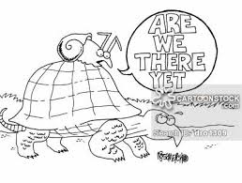
Dental doesn’t have to be a lost leader
Dental doesn’t have to lose money
Yes! It is possible
There are things you can do
Yes! It can be done
Don’t give up!

Slide 36
The Importance of Credible Data: How to learn from your mistakes
Dr. Maryna Petrasheuskaya DDS
Associate Dental Director
Community Health Net

Slide 37
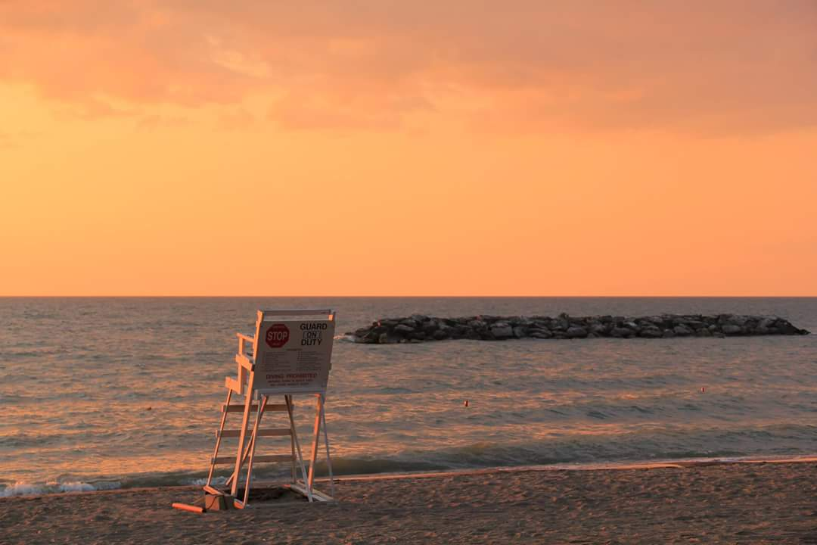
Importance of credible data: How to learn from your mistakes
Dr. Maryna Petrasheuskaya DDS
Community Health Net
Associate Dental Director

Slide 38
Who We Are
Community Health Net Founded in 1985
FQHC
Provide medical, dental and vision services
Pharmacy on site
Recently opened school-based office

Slide 39
Who We Are: Dental Department
4 dental offices in Erie PA
One office in the same building with Medical Department
Oral surgery focused office
Open 7 days a week
5 dentists, 3 hygienists, 3 EFDAs, a great team of talented staff

Slide 40
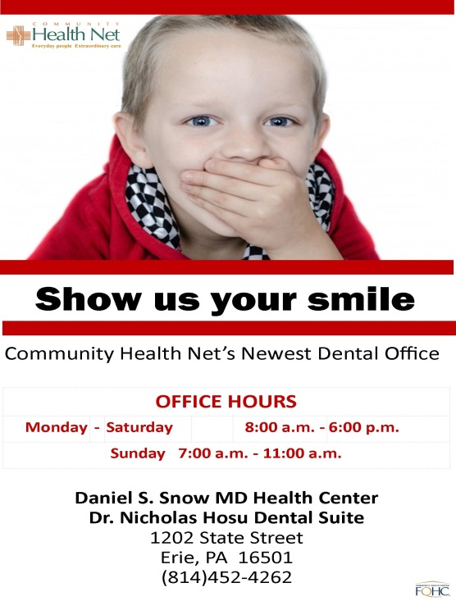
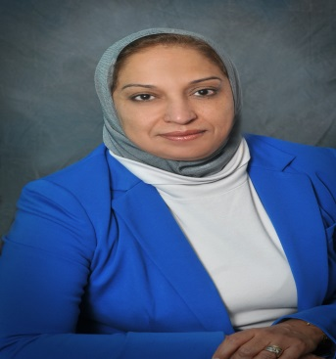
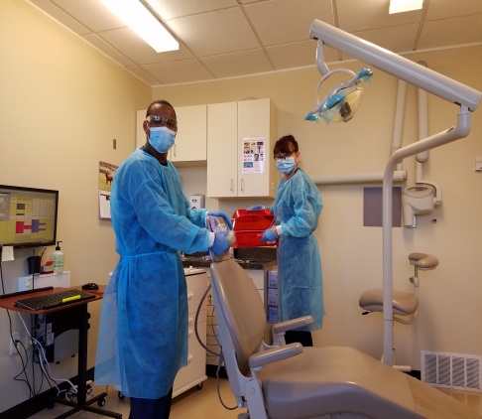
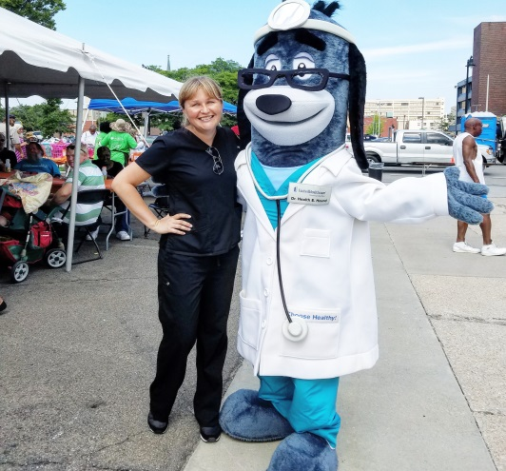
Who We Are

Slide 41
Collaboration with DentaQuest Institute and Safety Net Solutions
Received technical assistance in 2014
Multiple opportunities for improvement were identified
Areas include: finance, provider productivity, data tracking and reporting, quality measurement

Slide 42
Data Tracking and Reporting: Great Start
Treatment plan completion rate
Broken appointments number
Emergency visits tracking
Implementing of Dental Dashboard in progress

Slide 43
Broken Appointments Rate
When something is too good to be true, it definitely is!
Reported 2% no show rate to SNS
Dig deeper: no system was in place to correctly track and report broken appointments
Highlighted but not completed in Dentrix software
Real rate is around 30-35% at this time

Slide 44
Start from Scratch
New broken appointment and emergency visit policy in the works
Every patient is allowed 3 missed appointments per calendar year. After the 3rd one they can get on a same day sit-and-wait list, no more then 5 slots per day. Emergency care is provided
20 min late considered a no-show and 24 hour notice for cancellation required
No-show families won’t be able to schedule future appointments together

Slide 45
New Tracking and Monitoring
Complete the appointment in Dentrix EHR as a “no-show”
Run reports on a regular basis and find opportunities for improvement
Everyone is responsible for implementing the policy: both clinical staff, office staff, providers, leadership
Barriers: difficulties with transportation, no access to phones

Slide 46
Opportunities for Improvement: New Emergency Visit Policy
Difference between Urgent and Emergent situation
Swelling, trauma, uncontrolled bleeding, problems related to recent dental treatment at the office – Emergency
Fractured restoration, dull pain lasting for weeks, denture adjustments – Urgent
Patients are not scheduled at the time of emergency appointment for the follow up, must call the office in 2-3 days
All necessary treatment must be provided at the time of appointment, not just medications refills/prescriptions

Slide 47
Opportunities for Improvement: New Emergency Visit Policy
Every urgent patient will be encouraged to stay for comprehensive exam at the time of the visit
Barrier: patients seeking narcotics, multiple emergency visits without receiving recommended definitive treatment, broken appointments after emergency visit when patient feels better

Slide 48
Thank you for your attention! Come visit us in beautiful Erie PA and enjoy the best sunsets

Slide 49
A Better Bottom Line & Increased Patient Satisfaction
Bev Myers Director of Dental Care Services
Keystone Dental Care

Slide 50
 | July 2011 - Dec 2011 | January 2014 - June 2014 | January 2016 - June 2016 | 2016
 | Baseline | 6 Months | 6 Months | Increase/Decrease over Baseline
Visits | 9,205 | 10,339 | 11,860 | 2,655
Revenue per Visit | $137.83 | $140.31 | $277.07 | 139.24
Cost per Visit | $160.84 | $161.27 | $305.03 | 144.19
Unduplicated Patients | 3,000 | 5,575 | 7,005 | 4,005
New Patients | 900 | 776 | 1,777 | 877
Transactions | 20,063 | 24,349 | 36,586 | 16,523
No Show | 22% | 15% | 12.06% | -9.94%
FTE Providers | 11 | 8 | 9.75 | -1.25
Complete TX | n/a | 988 | 1,102 | 114
Under 21 Sealants | n/a | 272 | 404 | 132
Sealants | 1,520 | 1,168 | 1,513 | -7
Safety Net Recommendations
March 2012 Recommendations on No-shows
*Get tough with no-shows, create culture of accountability
* The goal is to create a family practice of patients who understand the value Keystone Dental represents and are willing to play by the rules
*Place repeat offenders on a same-day call basis rather than discharging them from the practice.
March 2012 Other Recommendations
*Quadrant dentistry should be the standard of care at Keystone Dental.
*Emergency patients should receive definitive care.

Slide 51
Contact Information
Caroline Darcy
SNS Project Manager, Technical Assistance
Ph. 508-329-2412
Caroline.Darcy@Dentaquestinstitute.org
Additional Resources:
www.dentaquestinstitute.org

Slide 52
Partnering to Strengthen and Preserve
the Oral Health Safety Net
2400 Computer Drive, Westborough, MA 01581 Tel: 508-329-2280 Fax: 508-329-2285 www.dentaquestinstitute.org

